Slide 1
Member Engagement and Retention
Re-name Yourself in Zoom
(include your role)
Example: VPE Sandy Chen
For Technology Support
Chat with Zoom Master

Slide 2
Member Retention and Engagement
Session #
Please “re-name” yourself to include your role
(Example: VPE Sandy Chen)
Receive participant workbook in chat

Slide 3
Agenda
Member Engagement
and Retention
Retaining Members
Re-engaging Past Members

Slide 4
Develop
Develop
Develop strategies to retain members
Develop strategies to re-engage past members

Slide 5
Retaining Members

Slide 6
What brings people to Toastmasters?
What are their goals?

Slide 7
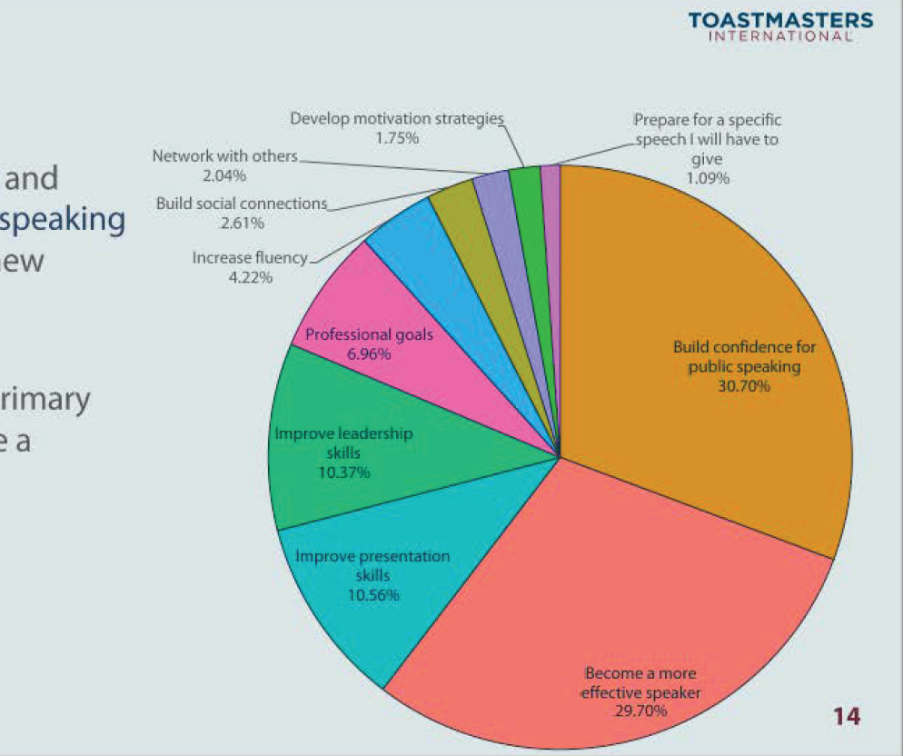
Member Goals

Slide 8
Breakout Room Activity: Connecting Benefits to Goals

Slide 9
Breakout Room Tips
Click “Join Breakout Room” button
Use Zoom tools as needed (Share Screen, Annotate, Whiteboard)
Assign a Timekeeper
Watch for Broadcast and Chat messages
Use “Ask For Help” button
Join Breakout Room

Slide 10
Connecting Goals to Benefits Activity Instructions
Join your team in a breakout room (automatic)
Select a goal from the Member Goals chart that represents the most popular goal from the clubs that your group represents
Answer the questions and select a spokesperson to present your group’s key ideas and takeaways for up to 2 minutes
You have 20 minutes
Start on page 2 in your Participant Workbook

Slide 11
Present your results, key ideas, and recommendations for each phase
(1-2 minutes per team)

Slide 12
Review: Retaining Members
Connect to member goals
Recognize success

Slide 13
Re-engaging past members
AGAIN

Slide 14
Why do members not renew?

Slide 15
How are past members currently involved in your club?

Slide 16
Breakout Room Activity: Bringing past members Back

Slide 17
Breakout Room Tips
Click “Join Breakout Room” button
Use Zoom tools as needed (Share Screen, Annotate, Whiteboard)
Assign a Timekeeper
Watch for Broadcast and Chat messages
Use “Ask For Help” button
Join Breakout Room

Slide 18
Re-engaging past members Activity Instructions
Join your team in a breakout room (automatic)
Discuss how to meaningfully re-engage past members
Select a spokesperson to present your group’s key ideas and takeaways for up to 2 minutes
You have 20 minutes
Start on page 4 in your Participant Workbook

Slide 19
Present your results, key ideas, and recommendations
(up to 2 minutes per team)

Slide 20
Review: Re-engaging past members
Build opportunities for past members to reconnect with your club

Slide 21
Conclusion
Member Engagement
and Retention
Retaining Members
Re-engaging Past Members

Slide 22
What is one thing you learned from this session that you will implement in your club?

Slide 23
Session Assessment
Go to link in Chat
You have 5 minutes

Slide 24
[Insert text]

